Slide 1

P peline
The Data
Acquiring Data: Theory
© Jennifer Mankoff
The Data Pipeline; HCII; Spring 2014

Slide 2
Quick aside: Questions for Byte 2
Question 1 : Handin your URL
Question 2 : Describe an expectation you had about the data that did not match the actual data. What was your expectation? How did things turn out? Illustrate your point with a graph or a chart.

Slide 3
Quick aside: Questions for Byte 2
Question 2 :
The answer to this question should focus on a specific expectation or assumption and does require you to list several (although we hope you have explored other assumptions during this assignment

Slide 4
Quick aside: Questions for Byte 2
Question 3 :
Describe an issue with the completeness, coherence, or correctness of the data of the data. Be concrete about what type of problem you are talking about, how much data is involved and what is affected. What concerns does this raise?

Slide 5
Theory: The Data you Want and the Data you Get

Slide 6
Where do we sample from?
Population about whom you are asking a question
‘response’ (the information we want from them)
Notes:
Examples of what this could be?
‘response’ is the data they generate
‘statistic’ is a measure of that variable across the entire sample
‘parameter’ is a a measure of that variable across the entire population

Slide 7
Where do we sample from?
‘response’ (the information we want from them)
Sample: The population we actually get responses from
Notes:
Examples of what this could be?
‘response’ is the data they generate
‘statistic’ is a measure of that variable across the entire sample
‘parameter’ is a a measure of that variable across the entire population

Slide 8
Independent Samples (infinite)
‘response’ (the information we want from them)
Notes:
Examples of what this could be?
‘response’ is the data they generate
‘statistic’ is a measure of that variable across the entire sample
‘parameter’ is a a measure of that variable across the entire population
the average of the sampling distribution is essentially equivalent to the parameter. (if we have a good sample) – the more samples the closer it gets.
A crucial midway concept you need to understand is the sampling distribution. In order to understand it, you have to be able and willing to do a thought experiment. Imagine that instead of just taking a single sample like we do in a typical study, you took three independent samples of the same population. And furthermore, imagine that for each of your three samples, you collected a single response and computed a single statistic, say, the mean of the response. Even though all three samples came from the same population, you wouldn't expect to get the exact same statistic from each. The distribution of an infinite number of samples of the same size as the sample in your study is known as the sampling distribution.
When we keep the sampling distribution in mind, we realize that while the statistic we got from our sample is probably near the center of the sampling distribution (because most of the samples would be there) we could have gotten one of the extreme samples just by the luck of the draw

Slide 9
‘Random’ Sampling Error
Generally decreases as the sample size increases (but not proportionally)
Depends on the variability of the characteristic of interest in the population
Notes:
the average of the sampling distribution is essentially equivalent to the population parameter.
The standard deviation of the sampling distribution tells us something about how different samples would be distributed. In statistics it is referred to as the standard error. In sampling contexts it is called the sampling error
how do we calculate sampling error? We base our calculation on the standard deviation of our sample.
The bigger the sample, the closer your sample is to the actual population itself, the smaller the sampling error will be.
Let's assume we did a study and drew a single sample from the population. Furthermore, let's assume that the average for the sample was 3.75 and the standard deviation was .25. This is the raw data distribution depicted above. now, what would the sampling distribution be in this case? Well, we don't actually construct it (because we would need to take an infinite number of samples) but we can estimate it. For starters, we assume that the mean of the sampling distribution is the mean of the sample, which is 3.75. Then, we calculate the standard error. To do this, we use the standard deviation for our sample and the sample size (in this case N=100) and we come up with a standard error of .025 (just trust me on this). Now we have everything we need to estimate a confidence interval for the population parameter. We would estimate that the probability is 68% that the true parameter value falls between 3.725 and 3.775 (i.e., 3.75 plus and minus .025); that the 95% confidence interval is 3.700 to 3.800; and that we can say with 99% confidence that the population value is between 3.675 and 3.825. The real value (in this fictitious example) was 3.72 and so we have correctly estimated that value with our sample.
http://www.socialresearchmethods.net/kb/sampstat.php

Slide 10
‘Systematic Bias’ in Sampling
Does not decrease as the sample size increases (but not proportionally)
Depends on assumptions made by the experimenter about the population
Notes:
the average of the sampling distribution is essentially equivalent to the parameter.
The standard deviation of the sampling distribution tells us something about how different samples would be distributed. In statistics it is referred to as the standard error. In sampling contexts it is called the sampling error
how do we calculate sampling error? We base our calculation on the standard deviation of our sample.
The bigger the sample, the closer your sample is to the actual population itself, the smaller the sampling error will be.
Let's assume we did a study and drew a single sample from the population. Furthermore, let's assume that the average for the sample was 3.75 and the standard deviation was .25. This is the raw data distribution depicted above. now, what would the sampling distribution be in this case? Well, we don't actually construct it (because we would need to take an infinite number of samples) but we can estimate it. For starters, we assume that the mean of the sampling distribution is the mean of the sample, which is 3.75. Then, we calculate the standard error. To do this, we use the standard deviation for our sample and the sample size (in this case N=100) and we come up with a standard error of .025 (just trust me on this). Now we have everything we need to estimate a confidence interval for the population parameter. We would estimate that the probability is 68% that the true parameter value falls between 3.725 and 3.775 (i.e., 3.75 plus and minus .025); that the 95% confidence interval is 3.700 to 3.800; and that we can say with 99% confidence that the population value is between 3.675 and 3.825. The real value (in this fictitious example) was 3.72 and so we have correctly estimated that value with our sample.
http://www.socialresearchmethods.net/kb/sampstat.php

Slide 11
Survey
How many hours of sleep did you get last night?
http://tinyurl.com/k6xwvnm
Content borrowed from Bill Thies
Notes:
https://www.usablestats.com/calcs/2samplet&summary=1

Slide 12
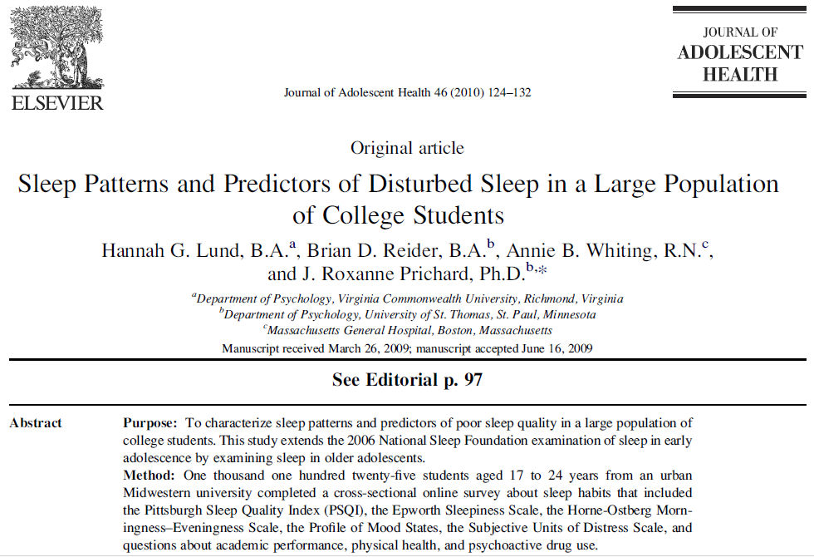

Slide 13
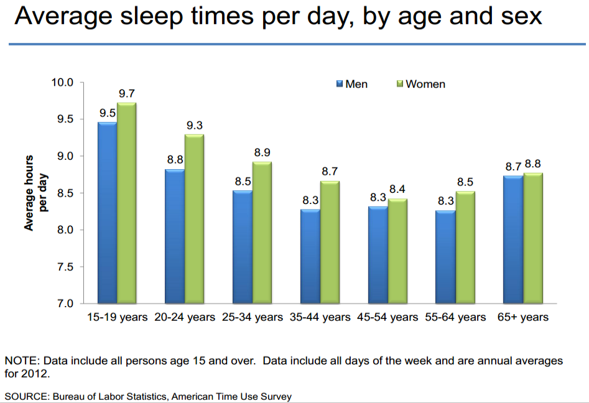

Slide 14
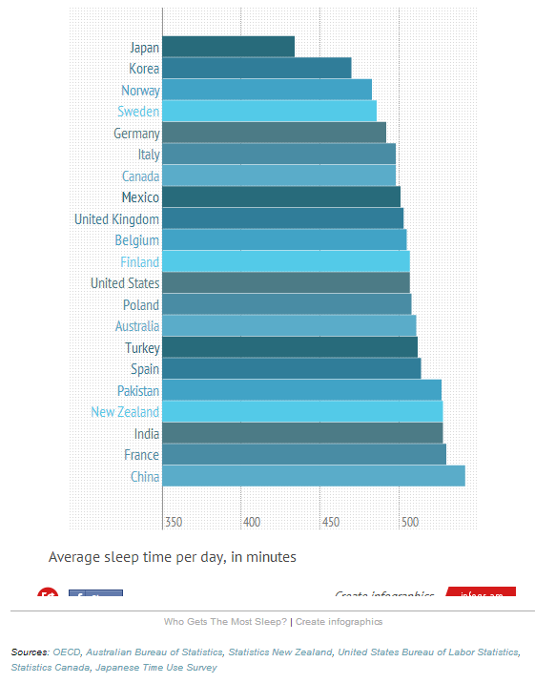

Slide 15
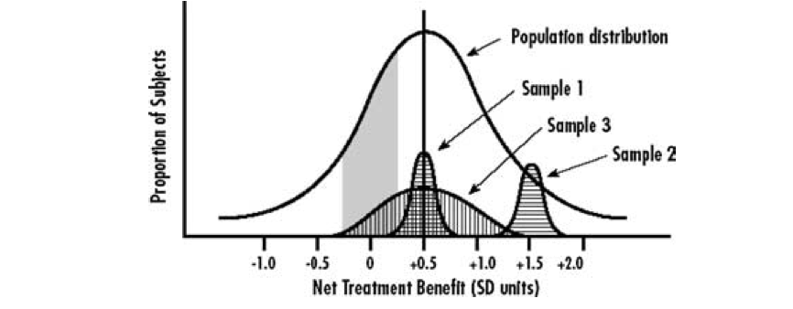
What Makes a Good Sample?
Representative of the population
(Along dimensions that matter to the question being asked)
Figure 1: Kravitz et al, (2004) Evidence-based medicine, heterogeneity of treatment effects, and the trouble with averages. The Milbank Quarterly 82(4):661-687
Notes:
Sample 1 is centered but not representative of true diversity. Sample 2 is biased (in this case, medical treatment, individuals who benefit more than most). Sample 3 is good (broadly representative in terms of risk, responsivity, and vulnerability)

Slide 16
Example: Medical Treatment Studies
For medical treatment we care about
Risk without treatment (baseline risk if untreated)
Responsiveness & Vulnerability to treatment (could be affected by biological or environmental differences) One is neg; one pos.
Notes:
What is worst is if the results are understood and applied without taking the sampling bias into account

Slide 17
Example: Lyme Disease
General Population

Slide 18
The CDC Estimates 300,000 per year contract Lyme disease

Slide 19
The CDC Estimates 300,000 per year contract Lyme disease
Our study (yellow circle) examines 3090 individuals drawn from those with chronic Lyme disease, a population that has not been studied previously
Notes:
What dimension matters here? How chronic their illness is!

Slide 20
Using Secondary Data for Verification
How do you determine the quality of the sample you have?
Compare demographics to ‘known, good’ samples (e.g., census data)
Needs to relate to variables of interest
Notes:
----- Meeting Notes (1/22/15 10:04) -----
multiple samples

Slide 21
The CDC Estimates 300,000 per year contract Lyme disease
The 5,000 cases on which our current understanding of Lyme Disease is based

Slide 22
The CDC Estimates 300,000 per year contract Lyme disease
Of these, the CDC found just 21 (1/2 %) had chronic Lyme disease

Slide 23
But what if your population looks like this?
Notes:
Bias in your sample…

Slide 24
The CDC Estimates 300,000 per year contract Lyme disease
But estimates suggest that approximately 36% of people with Lyme disease develop chronic symptoms
Of these, the CDC found just 21 (1/2 %) had chronic Lyme disease
Notes:
What does this tell us about the 5,000 person sample (if estimates are correct?)

Slide 25
The CDC Estimates 300,000 per year contract Lyme disease
Our study (yellow circle) examines 3090 individuals drawn from those with chronic Lyme disease, a population that has not been studied previously

Slide 26
Selection Bias
A statistical bias in which there is an error in choosing the individuals or groups to take part in a scientific study
Many potential sources
Sampling bias
Time of selection
Exposure to the study
Self-selection
Content borrowed from Bill Thies

Slide 27
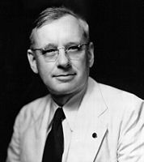
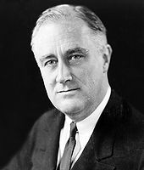


The Literary Digest Poll
1936 US Presidential Election
Alf Landon (R) vs. Franklin D. Roosevelt (D)
Slide Credit: Damian Gordon, Dublin Institute of Technology

Slide 28








The Literary Digest Poll
Slide Credit: Damian Gordon, Dublin Institute of Technology

Slide 29

The Literary Digest Poll
Literary Digest had been conducting successful presidential election polls since 1916
They had correctly predicted the outcomes of the 1916, 1920, 1924, 1928, and 1932 elections by conducting polls.
These polls were a lucrative venture for the magazine: readers liked them; newspapers played them up; and each “ballot” included a subscription blank.
Slide Credit: Damian Gordon, Dublin Institute of Technology

Slide 30
The Literary Digest Poll
In 1936 they sent out 10 million ballots to two groups of people:
Prospective subscribers, “who were chiefly upper- and middle-income people”
A list designed to "correct for bias" from the first list, consisting of names selected from telephone books and motor vehicle registries
Slide Credit: Damian Gordon, Dublin Institute of Technology

Slide 31

Slide Credit: Damian Gordon, Dublin Institute of Technology

Slide 32

The Literary Digest Poll
Response rate: approximately 25%, or 2,376,523 responses
Result: Landon in a landslide (predicted 57% of the vote, Roosevelt predicted 40%)
Slide Credit: Damian Gordon, Dublin Institute of Technology

Slide 33
The Literary Digest Poll
Response rate: approximately 25%, or 2,376,523 responses
Result: Landon in a landslide (predicted 57% of the vote, Roosevelt predicted 40%)
Election result: Roosevelt received approximately 60% of the vote
Slide Credit: Damian Gordon, Dublin Institute of Technology

Slide 34
The Literary Digest Poll
POSSIBLE CAUSES OF ERROR
Selection Bias: By taking names and addresses from telephone directories, survey systematically excluded poor voters.
Republicans were markedly overrepresented
In 1936, Democrats did not have as many phones, not as likely to drive cars, and did not read the Literary Digest
Any other causes?
Slide Credit: Damian Gordon, Dublin Institute of Technology

Slide 35
The Literary Digest Poll
POSSIBLE CAUSES OF ERROR
Non-response Bias: Because only 20% of 10 million people returned surveys, non-respondents may have different preferences from respondents
Indeed, respondents favored Landon
Greater response rates reduce the odds of biased samples
Slide Credit: Damian Gordon, Dublin Institute of Technology

Slide 36
Was there selection bias in our Lyme Disease sample?
We surveyed people in online mailing lists & used ‘snowball’ sampling
Other options?

Slide 37
Was there selection bias in our Lyme Disease sample?
We surveyed people in online mailing lists & used ‘snowball’ sampling
Other options?
Randomly call phone numbers in different regions
Hang out in doctors’ offices
Advertise on buses and billboards

Slide 38
Is there selection bias here?
Personal data can piggyback on existing devices (e.g., Make an android app people want to use (e.g. battery alerts) and give it free in return for data)
Public data can too (satellite data for example; or our current work with the Gates building)

Slide 39
What if you are not doing a survey?
Personal data can piggyback on existing devices (e.g., Make an android app people want to use (e.g. battery alerts) and give it free in return for data)
Public data can too (satellite data for example; or our current work with the Gates building)
Notes:
Biases here?

Slide 40
What if you are not doing a survey?
Personal data can piggyback on existing devices (e.g., Make an android app people want to use (e.g. battery alerts) and give it free in return for data)
Public data can too (satellite data for example; or our current work with the Gates building)
Notes:
Biases here?

Slide 41
Bias
Address when you plan your sample

